Slide 1

Project: TA Report Web App
IE04 Weekly Progress Report, Phase Demo 2
2023/01/10
Team: Pikachu

Slide 2
Activities of Previous Week
Task | Member | Work Hours
(API Integration) report screen | Merci | 2:30
(API Integration) add new report pop-up | Merci | 3:30
(API Integration) shifts addition [debug] | Merci | 3:30
(front-end) Admin screen: approve and unlock | Youssef | 2:30
(front-end) Faculty screen: approve | Youssef | 2:30
 | Total time: | 17h:00

Slide 3
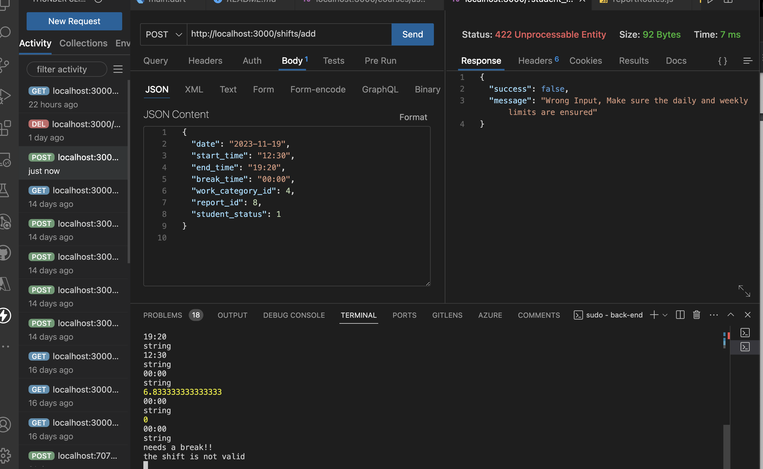
API

Slide 4
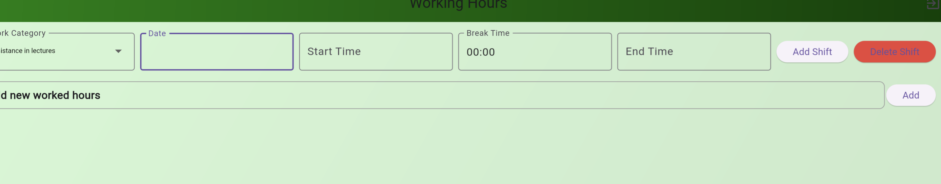
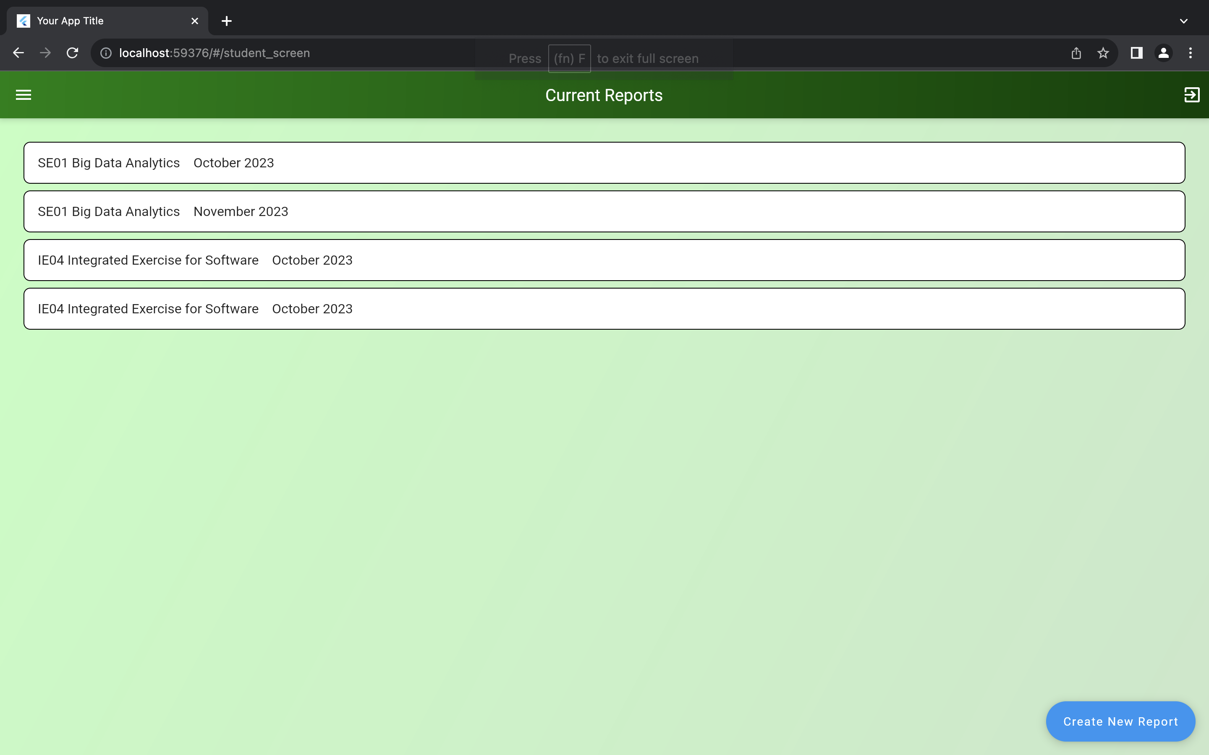
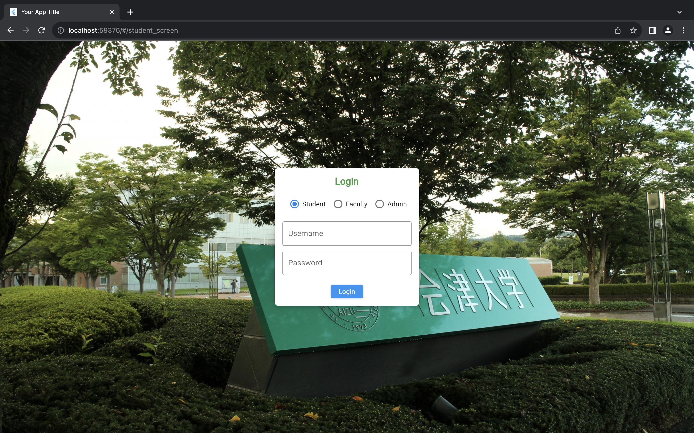
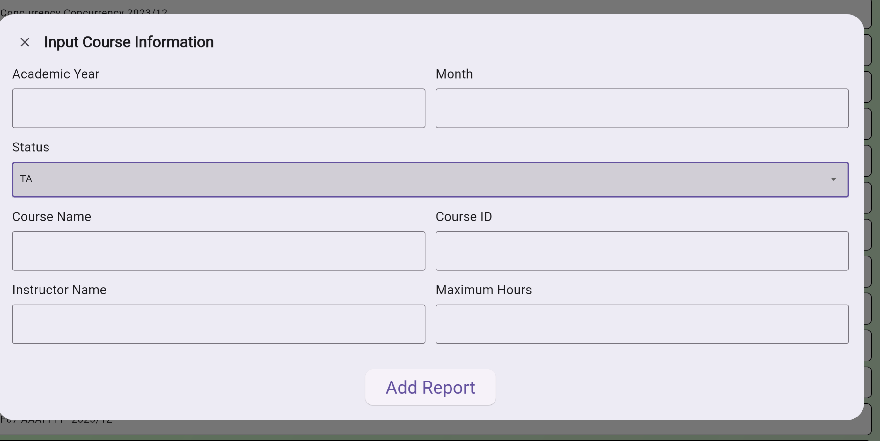
UI

Slide 5
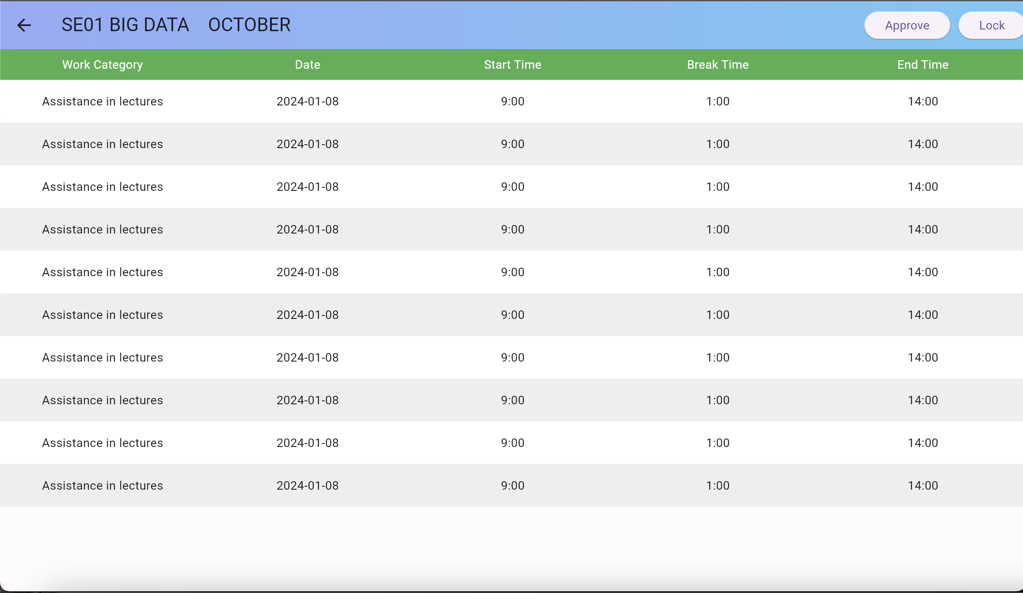
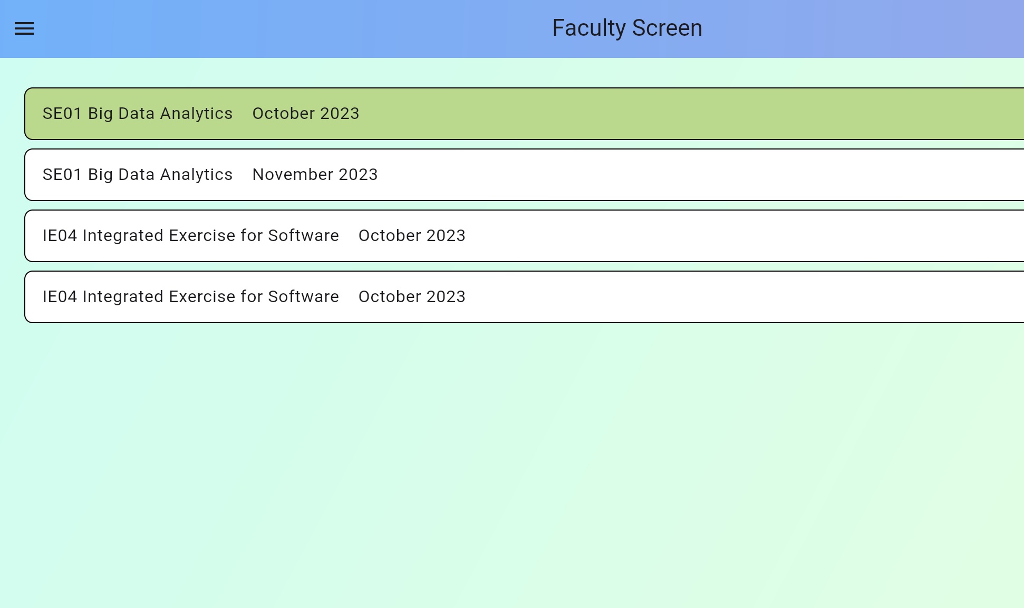
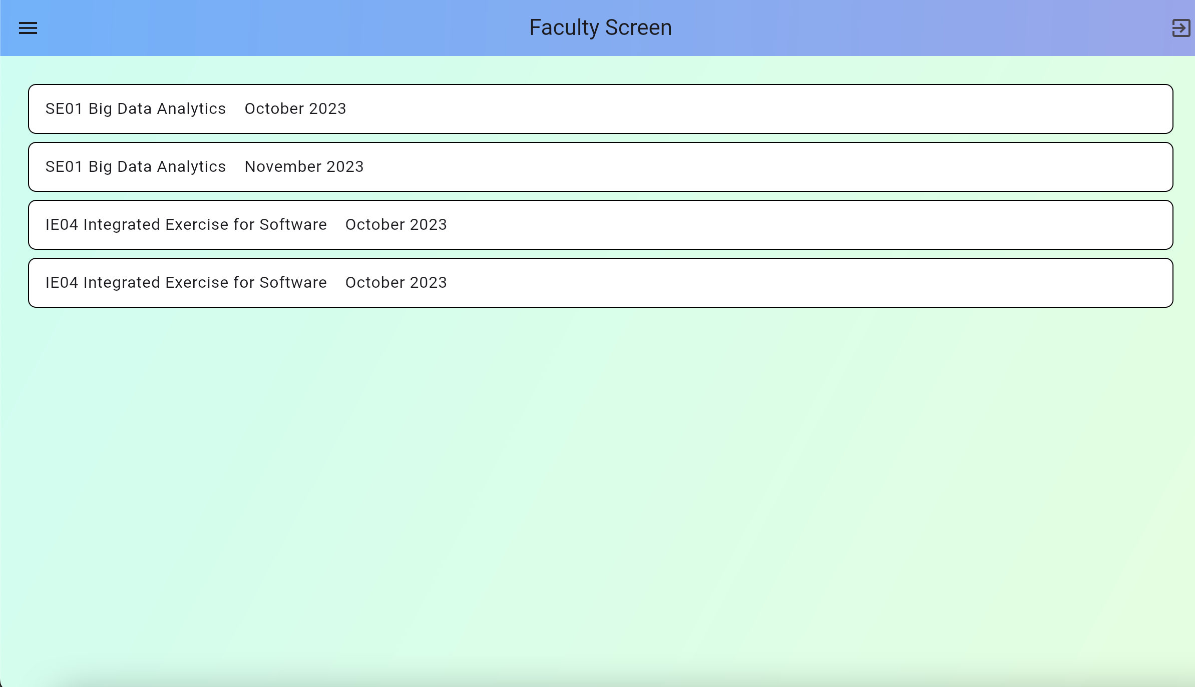
UI

Slide 6
Plan for Next Week
Task | Member | Work Hours
Shifts screen debugging: - add shift function - delete shifts function - edit shift function | Youssef & Merci | 22:30
Faculty and student integration: - Student submit function, pdf print function, | Merci | 10:00
Admin and student integration: Faculty submit function | Youssef | 10:30
 | Total time: | 50h:00

Slide 7
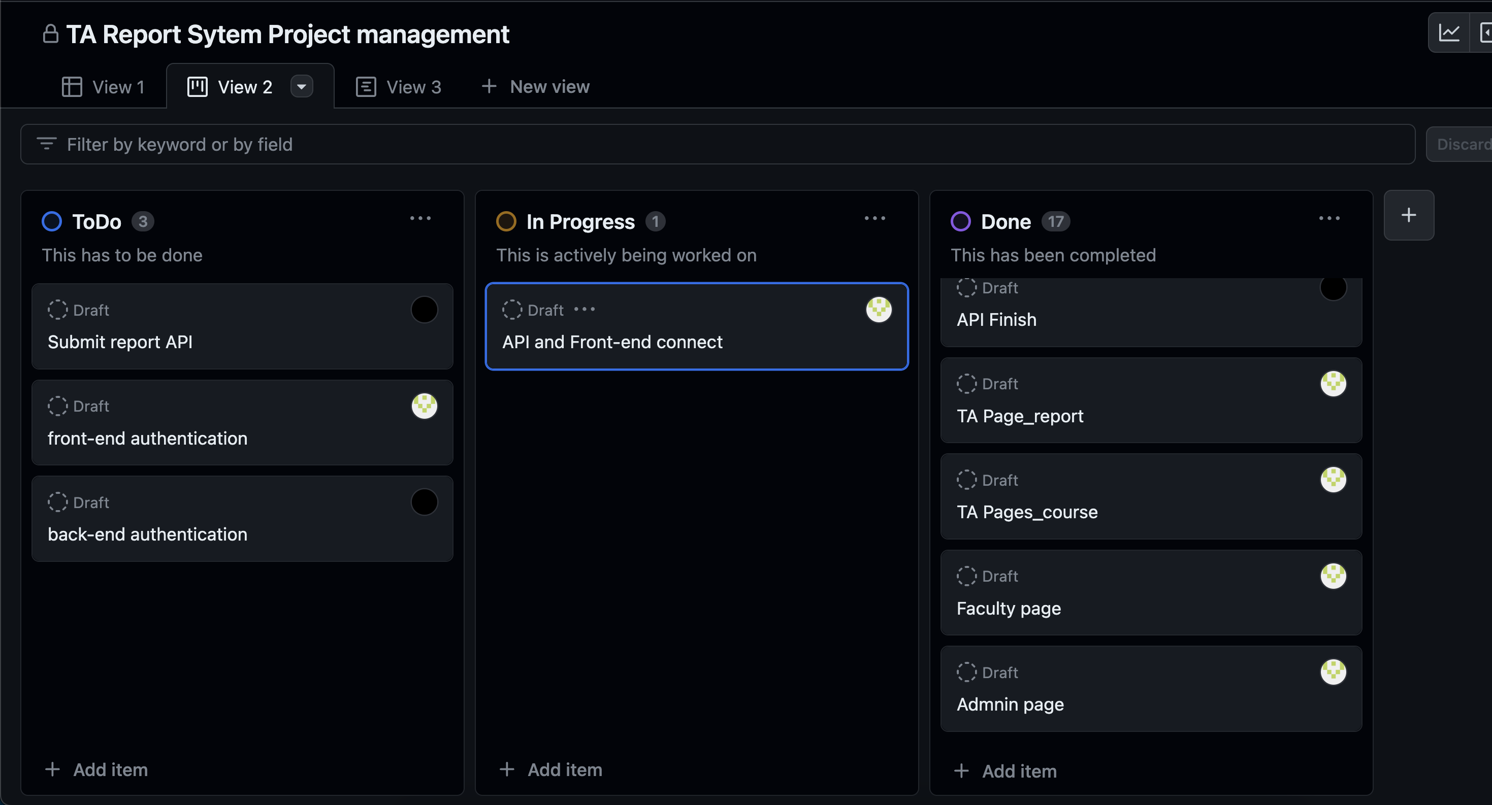
Phase Task Board

Slide 8
Issues & Risks (*if any)
Problem: API errors, still implementing thorough connections
Cause: Unchecked Bugs
Possible Solution: do all checks for negative and wrong inputs
Deadline: Jan 25, 2024

Slide 9

Thank you

